Slide 1
CS3006 Parallel and Distributed Computing
Fall 2022
National University of Computer and Emerging Sciences

Slide 2
Chapter 7. Programming Shared Address Space Platforms

Slide 3
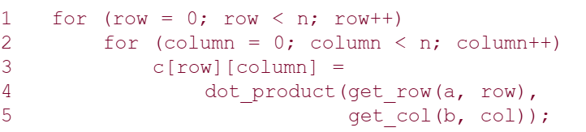
Thread Basics
A thread is a single stream of control in the flow of a program. A program like:
The for loop in this code fragment has n² iterations, each of which can be executed independently. Such an independent sequence of instructions is referred to as a thread

Slide 4
There are n² threads, one for each iteration of the for-loop.
Since each of these threads can be executed independently of theothers, they can be scheduled concurrently on multiple processors.
for (row = 0; row < n; row++)
for (column = 0; column < n; column++)
c[row][column] = create_thread(dot_product(get_row(a, row), get_col(b, col)));
In this case, one may think of the thread as an instance of a function that returns before the function has finished executing.
To execute the above code fragment on multiple processors, each processor must have access to matrices a, b, and c.

Slide 5
Thread Basics: Creation and Termination
#include <pthread.h>
// A normal C function that is executed as a thread
// when its name is specified in pthread_create()
void *myThreadFun(void *vargp)
{
sleep(1);
printf("Printing GeeksQuiz from Thread \n");
return NULL;
}
int main()
{
pthread_t thread_id;
printf("Before Thread\n");
pthread_create(&thread_id, NULL, myThreadFun, NULL);
pthread_join(thread_id, NULL);
printf("After Thread\n");
exit(0);
}

Slide 6
In main() we declare a variable called thread_id, which is of type pthread_t, which is an integer used to identify the thread in the system.
After declaring thread_id, we call pthread_create() function to create a thread. pthread_create() takes 4 arguments
The first argument is a pointer to thread_id which is set by this function.
The second argument specifies attributes. If the value is NULL, then default attributes shall be used.
The third argument is name of function to be executed for the thread to be created.
The fourth argument is used to pass arguments to the function, myThreadFun

Slide 7
A call to pthread_join waits for the termination of the thread whose id is given by thread_id.
On a successful call to pthread_join, the value passed to pthread_exit is returned in the location pointed to by the second argument.
On successful completion, pthread_join returns 0, else it returns an error-code.

Slide 8
Synchronization Primitives in Pthreads
When multiple threads attempt to manipulate the same data item, the results can often be incoherent if proper care is not taken to synchronize them.
Consider:
/* each thread tries to update variable best_cost as follows */
if (my_cost < best_cost)
best_cost = my_cost;
Assume that there are two threads, the initial value of best_cost is 100, and the values of my_cost are 50 and 75 at threads t1 and t2.
Depending on the schedule of the threads, the value of best_cost could be 50 or 75!
The value 75 does not correspond to any serialization of the threads.

Slide 9
Mutual Exclusion
The code in the previous example corresponds to a critical segment; i.e., a segment that must be executed by only one thread at any time.
Critical segments in Pthreads are implemented using Mutex locks (mutual exclusion locks)
Mutex-locks have two states: locked and unlocked. At any point of time, only one thread can lock a mutex lock. A lock is an atomic operation.
A thread entering a critical segment first tries to get a lock. It goes ahead when the lock is granted.
If the mutex-lock is already locked, the process trying to acquire the lock is blocked.
This is because a locked mutex-lock implies that there is another thread currently in the critical section and that no other thread must be allowed in.
Notes:
Polling

Slide 10
Mutual Exclusion
The Pthreads API provides the following functions for handling mutex-locks:
int pthread_mutex_lock(pthread_mutex_t *mutex_lock);
On leaving a critical section, a thread must unlock the mutex-lock associated with the section. If it does not do so, no other thread will be able to enter this section. Typically deadlock.
int pthread_mutex_unlock(pthread_mutex_t *mutex_lock);
On calling this function, in the case of a normal mutex-lock, the lock is relinquished and one of the blocked threads is scheduled to enter the critical section.

Slide 11
Mutual Exclusion
If a programmer attempts a pthread_mutex_unlock on a previously unlocked mutex or one that is locked by another thread, the effect is undefined.
OVERHEADS OF LOCKING
Locks represent serialization points since critical sections must be executed by threads one after the other.
Encapsulating large segments of the program within locks can, therefore, lead to significant performance degradation.
It is important to minimize the size of critical sections.

Slide 12
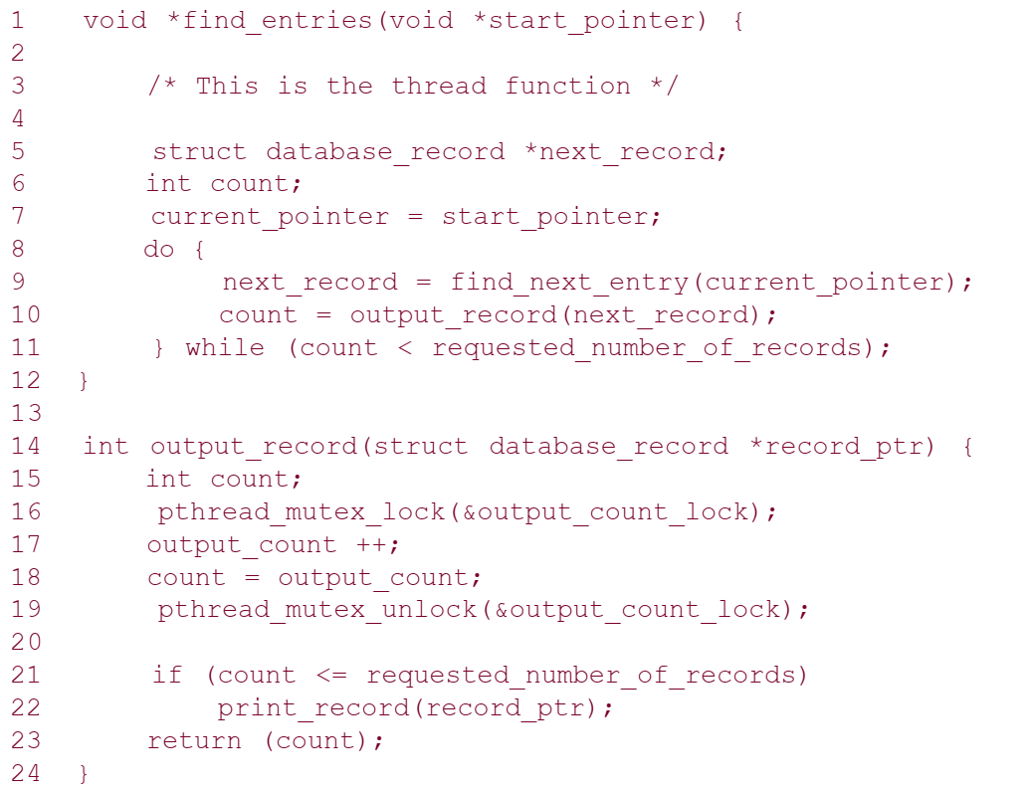
Example: Finding k matches in a list

Slide 13
Alleviating Locking Overheads
It is often possible to reduce the idling overhead associated with locks using an alternate function, pthread_mutex_trylock.
This function attempts a lock on mutex_lock. If the lock is successful, the function returns a zero. If it is already locked by another thread, instead of blocking the thread execution it returns a value EBUSY.
This allows the thread to do other work and to poll the mutex for a lock.

Slide 14
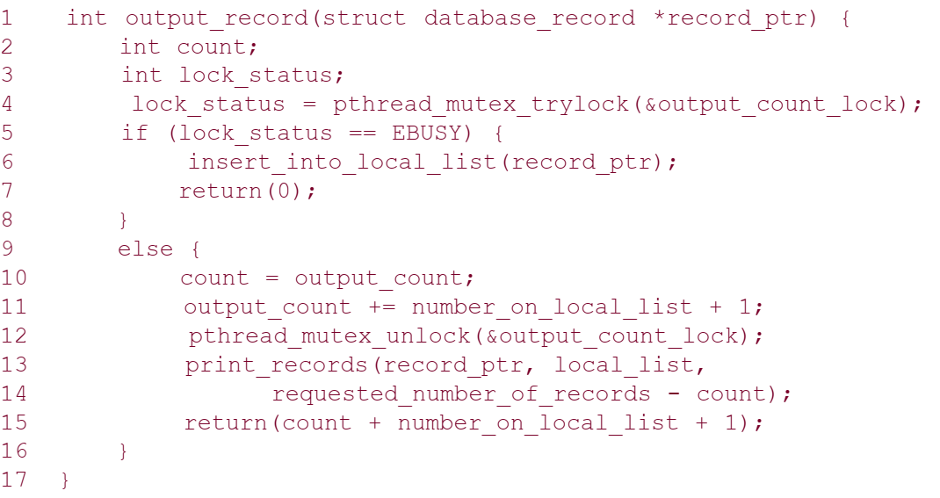

Slide 15
While the function pthread_mutex_trylock alleviates this overhead, it introduces the overhead of polling for availability of locks.
threads would have to periodically poll for availability of lock.
A natural solution to this problem is an interrupt driven mechanism as opposed to a polled mechanism.
The availability of space is signaled by the consumer thread that consumes the task.
The functionality to accomplish this is provided by a condition variable.
A condition variable is a data object used for synchronizing threads. This variable allows a thread to block itself until specified data reaches a predefined state.

Slide 16
OpenMP: a Standard for Directive Based Parallel Programming
OpenMP is a directive-based API that can be used with FORTRAN, C, and C++ for programming shared address space machines.
OpenMP directives provide support for concurrency, synchronization, and data handling while obviating the need for explicitly setting up mutexes, condition variables, data scope, and initialization.

Slide 17
OpenMP directives in C and C++ are based on the #pragma compiler directives.
#pragma omp directive [clause list]
OpenMP programs execute serially until they encounter the parallel directive.
#pragma omp parallel [clause list]
This directive is responsible for creating a group of threads.
The exact number of threads can be specified in the directive, set using an environment variable, or at runtime using OpenMP functions.
The main thread that encounters the parallel directive becomes the master of this group of threads and is assigned the thread id 0 within the group.

Slide 18
Each thread created by this directive executes the structured block specified by the parallel directive.
#pragma omp parallel [clause list]
/* structured block */
The clause list is used to specify conditional parallelization, number of threads, and data handling.

Slide 19
Conditional Parallelization: The clause if (scalar expression) determines whether the parallel construct results in creation of threads.
Only one if clause can be used with a parallel directive.
Degree of Concurrency: The clause num_threads (integer expression) specifies the number of threads that are created by the parallel directive.

Slide 20
Data Handling
The clause private (variable list) indicates that the set of variables specified is local to each thread – i.e., each thread has its own copy of each variable in the list.
The clause firstprivate (variable list) is similar to the private clause, except the values of variables on entering the threads are initialized to corresponding values before the parallel directive.
The clause shared (variable list) indicates that all variables in the list are shared across all the threads, i.e., there is only one copy. Special care must be taken while handling these variables by threads to ensure serializability.

Slide 21
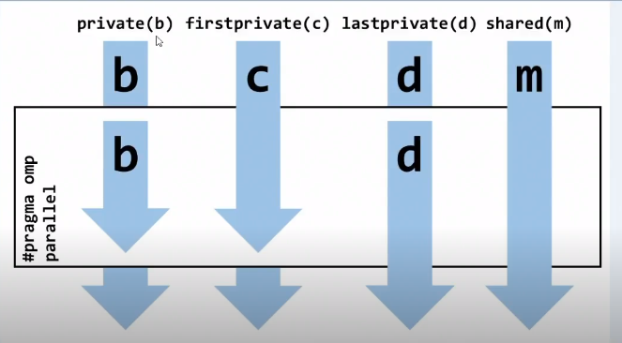

Slide 22
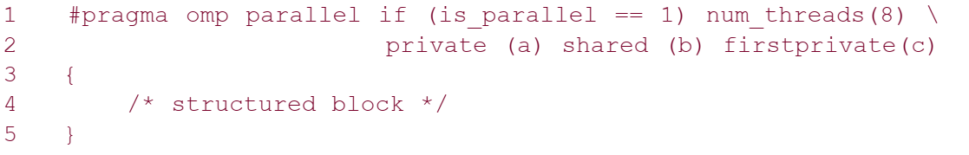
Using the parallel directive
Here, if the value of the variable is_parallel equals one, eight threads are created.
Each of these threads gets private copies of variables a and c, and shares a single value of variable b.
Furthermore, the value of each copy of c is initialized to the value of c before the parallel directive.

Slide 23
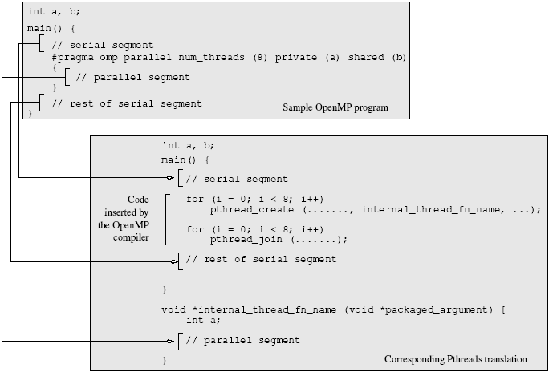
A sample OpenMP program along with its Pthreads translation that might be performed by an OpenMP compiler.

Slide 24
Clause | Description
private | Declares variables to be private to each thread in a team. Private copies of the variable are initialized from the original object when entering the region.
firstprivate | Provides a superset of the functionality provided by the private clause. Each private data object is initialized with the value of the original object.
lastprivate | Provides a superset of the functionality provided by the private clause. The original object is updated with the value of the private copy from the last sequential iteration of the associated loop, or the lexically last section construct, when exiting the region.
shared | Shares variables among all the threads in a team.
default | Enables you to affect the data-scope attributes of variables.
reduction | Performs a reduction on scalar variables.
ordered | The structured block following an ordered directive is executed in the order in which iterations would be executed in a sequential loop.

Slide 25
Clause | Description
if (expression) | If the if(expression)clause is present, the enclosed code block is executed in parallel only if the expression evaluates to TRUE. Otherwise the code block is serialized. The expression must be scalar logical.
schedule | Specifies how iterations of the for loop are divided among the threads of the team.
collapse(n) | Specifies how many loops are associated with the OpenMP loop construct for collapsing.
copyin | Provides a mechanism to copy the data values of the master thread to the variables used by the threadprivate copies at the beginning of the parallel region.
copyprivate | Provides a mechanism to use a private variable to broadcast a value from the data environment of one implicit task to the data environments of the other implicit tasks belonging to the parallel region.
nowait | Indicates that an implementation may omit the barrier at the end of the worksharing region.
untied | Indicates that a resumed task does not have to be executed by same thread executing it before it was suspended.
mergeable | Indicates that the task defined by this task pragma need not create a private data environment for the task, but if the task execution is deferred, then the private data environment is created.
final(expr) | The expr is evaluated, and if the value is true, then this task and all its descendant tasks are non-deferred (not executed in parallel).

Slide 26
The default state of a variable is specified by the clause default(shared) or default (none).
The clause default (shared) implies that, by default, a variable is shared by all the threads.
The clause default (none) implies that the state of each variable used in a thread must be explicitly specified. This is generally recommended, to guard against errors arising from unintentional concurrent access to shared data.

Slide 27
reduction clause
Just as firstprivate specifies how multiple local copies of a variable are initialized inside a thread, the reduction clause specifies how multiple local copies of a variable at different threads are combined into a single copy at the master when threads exit.
The OpenMP reduction clause lets you specify one or more thread-private variables that are subject to a reduction operation at the end of the parallel region.
OpenMP predefines a set of reduction operators. Each reduction variable must be a scalar (for example, int, long, and float).
OpenMP also defines several restrictions on how reduction variables are used in a parallel region.

Slide 28

The operator can be one of $+$, *, -, &, |, ^, &&, and ||

Slide 29
#pragma omp parallel reduction(+: sum) num_threads(8)
{
/* compute local sums here */
}
/* sum here contains sum of all local instances of sums
*/
In this example, each of the eight threads gets a copy of the variable sum.
When the threads exit, the sum of all of these local copies is stored in the single copy of the variable (at the master thread) .

Slide 30
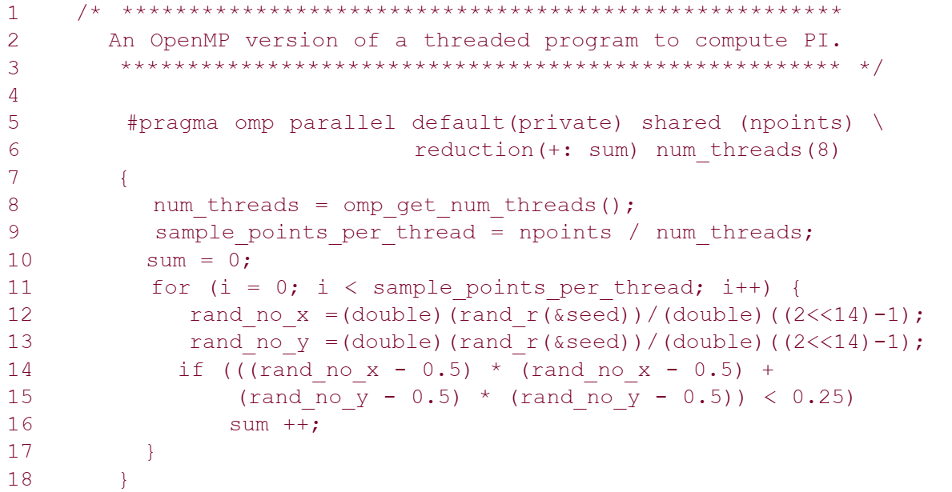

Slide 31
Specifying Concurrent Tasks in OpenMP
The parallel directive can be used in conjunction with other directives to specify concurrency across iterations and tasks.
OpenMP provides two directives – for and sections – to specify concurrent iterations and tasks.

Slide 32
The for Directive
The for directive is used to split parallel iteration spaces across threads. The general form of a for directive is as follows:
#pragma omp for [clause list]
/* for loop */
The clauses that can be used in this context are: private, firstprivate, lastprivate, reduction, schedule, nowait, and ordered.

Slide 33
The for Directive
When using a for loop for farming work to threads, it is sometimes desired that the last iteration (as defined by serial execution) of the for loop update the value of a variable.
This is accomplished using the lastprivate directive.
The lastprivate clause deals with how multiple local copies of a variable are written back into a single copy at the end of the parallel for loop.

Slide 34
Assigning Iterations to Threads
The schedule clause of the for directive deals with the assignment of iterations to threads.
The general form of the schedule directive is schedule(scheduling_class[, parameter]).
OpenMP supports four scheduling classes: static, dynamic, guided, and runtime.

Slide 35
Assigning Iterations to Threads
The general form of the static scheduling class is schedule(static[,chunk-size]).
E.g. The following for loop will be divided in 4 chunks, each with 5 iterations:
#pragma omp parallel for schedule(static, 5) num_threads(4)
for (i = 0; i < 20; i++)
When no chunk-size is specified, the total iterations are split into as many chunks as there are threads and one chunk is assigned to each thread.

Slide 36
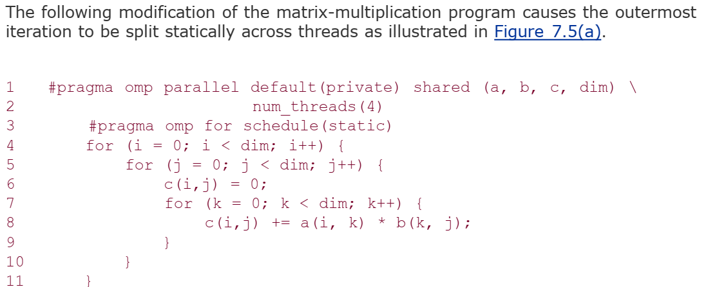

Slide 37
Dynamic
Often, because of a number of reasons, like heterogeneous computing resources to non-uniform processor loads, equally partitioned workloads take widely varying execution times.
For this reason, OpenMP has a dynamic scheduling class.
The general form of this class is schedule(dynamic[, chunk-size])
The iteration space is partitioned into chunks given by chunk-size. However, these are assigned to threads as they become idle.
This takes care of the temporal imbalances resulting from static scheduling. If no chunk-size is specified, it defaults to a single iteration per chunk.

Slide 38
// Enable OpenMP in Properties -> C / C++ -> Language
#include "stdafx.h"
#include <iostream>
#include <omp.h>
#include <stdio.h>
#define N 16
using namespace std;
void printVar(int a[], int b, int c, int d, int m) {
cout << "b = " << b << ", c = " << c << ", d = " << d << " m = " << m << endl;
cout << "a = ";
for (int i = 0; i < N; i++)
cout << a[i] << ", ";
cout << endl;
}

Slide 39
int main(){
int i;
int a[N];
int b = 0, c = 0, d = 0, m = 0;
cout << "Before par. for" << endl;
printVar(a, b, c, d, m); //Garbage Values
#pragma omp parallel for default(none) private(i,b) firstprivate(c) lastprivate(d) shared(m,a) schedule(static, 3) num_threads(4)
for (i = 0; i < N; i++) {
// b and d must be initialized
b = 100;
d = 10;
printf("Thread %d, iteration %d: b = %d, c = %d, d = %d, m = %d\n", omp_get_thread_num(), i, b, c, d, m);
a[i] = omp_get_thread_num();
b = omp_get_thread_num();
c = omp_get_thread_num();
d = omp_get_thread_num();
m = omp_get_thread_num();
}
cout << "After par. for" << endl;
printVar(a, b, c, d, m);
getchar();
return 0;
}

Slide 40
Guided
Consider the partitioning of an iteration space of 100 iterations with a chunk size of 5. This corresponds to 20 chunks. If there are 16 threads, in the best case, 12 threads get one chunk each and the remaining four threads get two chunks. this assignment results in considerable idling.
The solution to this problem (also referred to as an edge effect) is to reduce the chunk size as we proceed through the computation. This is the principle of the guided scheduling class.
The general form of this class is schedule(guided[, chunk-size]).
In this class, the chunk size is reduced exponentially as each chunk is dispatched to a thread. The chunk-size refers to the smallest chunk that should be dispatched.

Slide 41
Runtime
Often it is desirable to delay scheduling decisions until runtime.
For example, if one would like to see the impact of various scheduling strategies to select the best one, the scheduling can be set to runtime.
In this case the environment variable OMP_SCHEDULE determines the scheduling class and the chunk size.

Slide 42
Class Tasks
Calculate average of 100 elements' integer array using reduction clause. Use 8 threads only, also display the local results of every thread with its ID.
Write some program to differentiate between 'STATIC' and 'DYNAMIC' scheduling with parallel for.
Write a Parallel C++ program to calculate WORDCOUNT of some text file. Your program must have reduction clause, and also display the local results of each thread.

